Slide 1
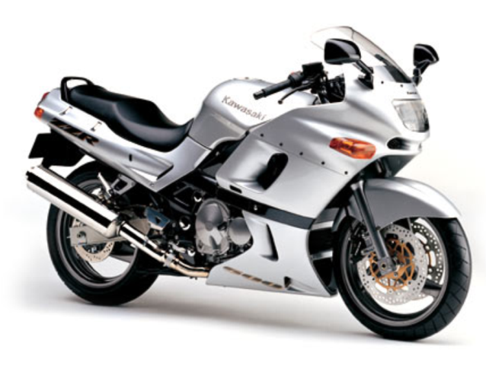
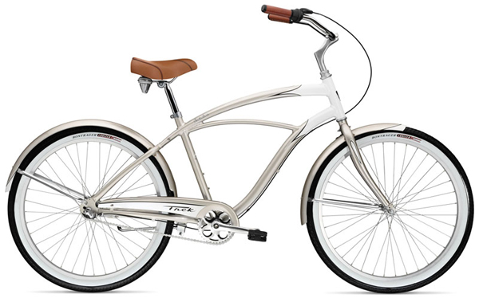
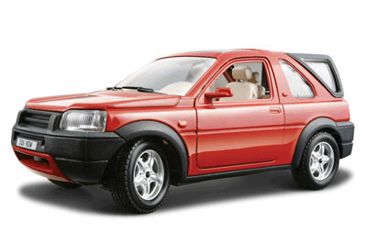
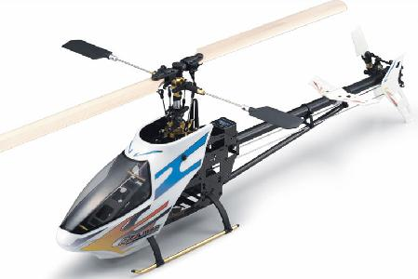
Travelling

Slide 2
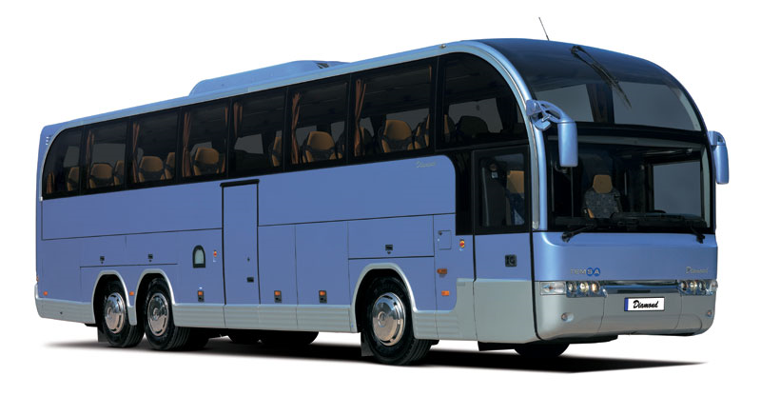
bus

Slide 3
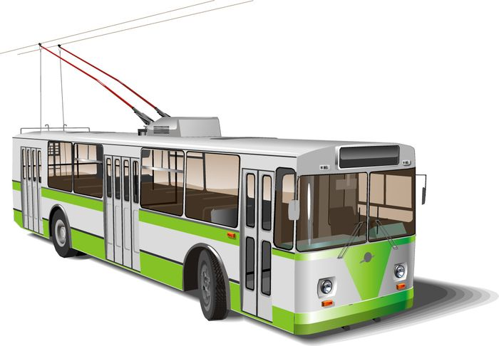
trolley-bus

Slide 4
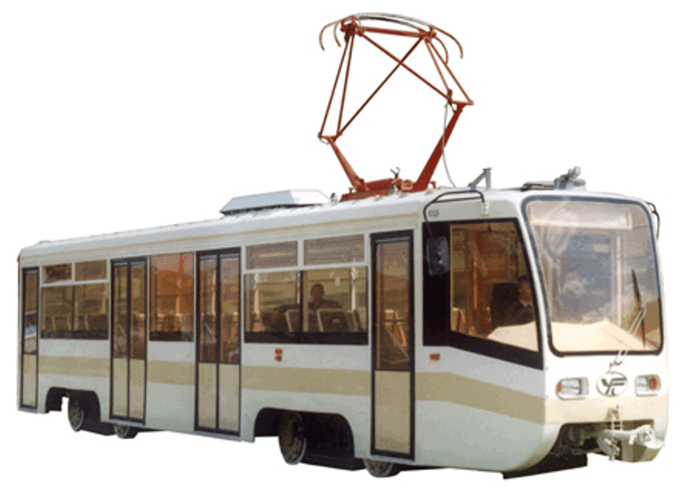
tram

Slide 5
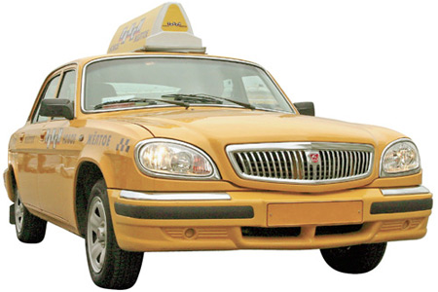
taxi

Slide 6
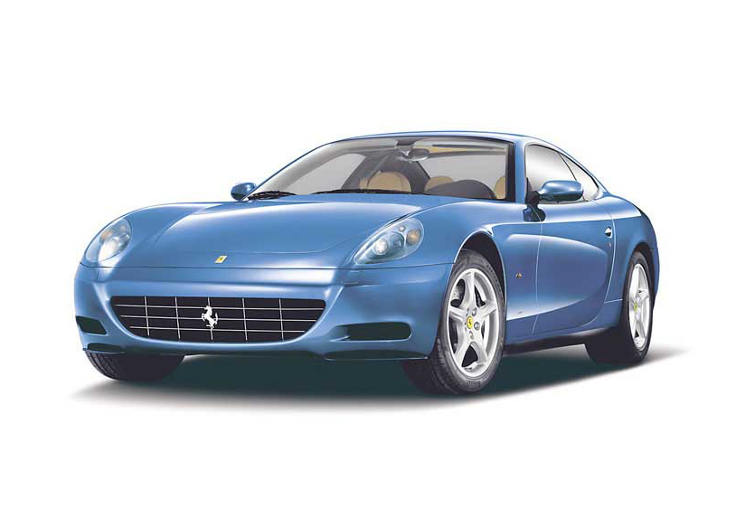
car

Slide 7
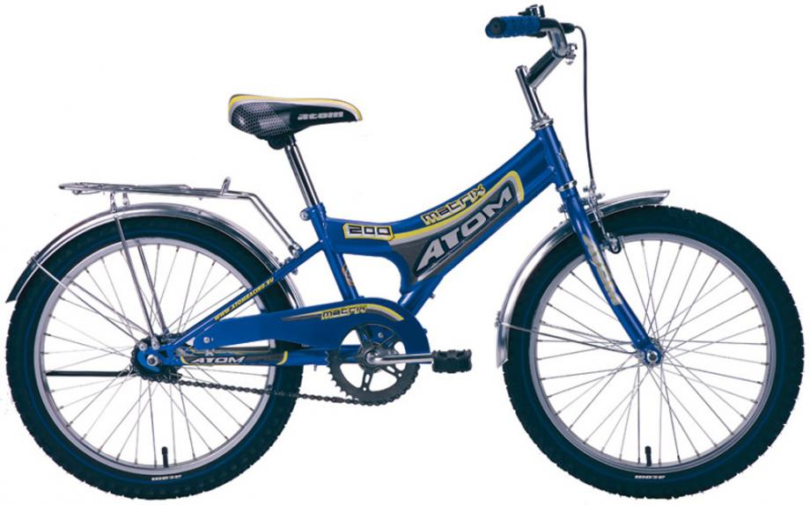
bicycle

Slide 8
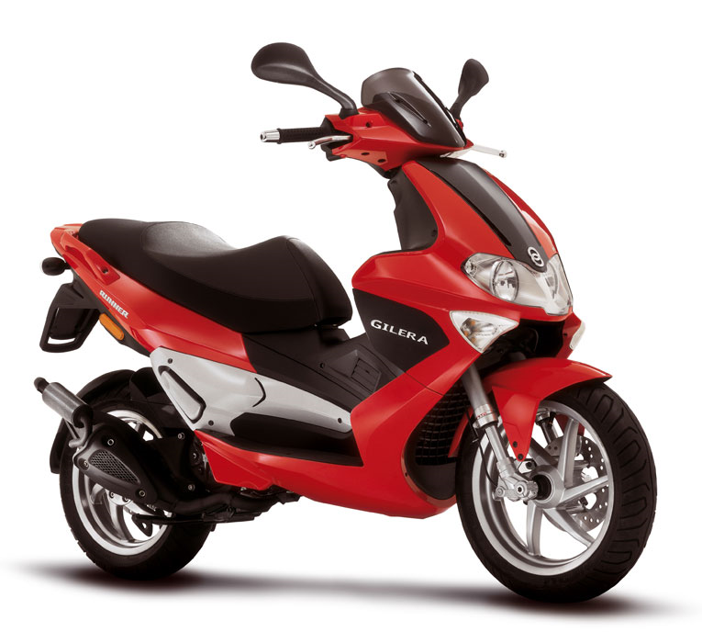
scooter

Slide 9
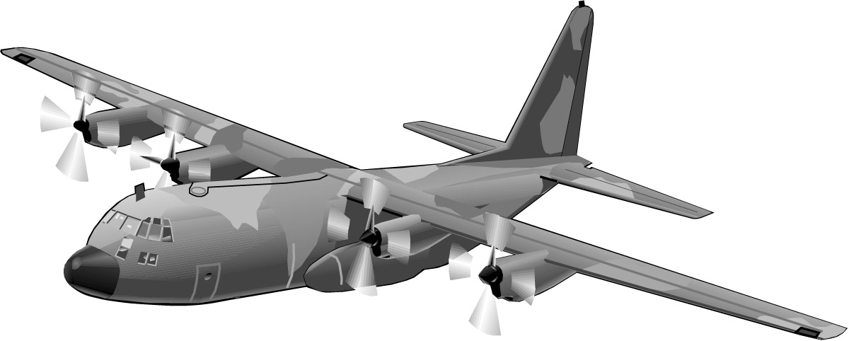
airplane

Slide 10
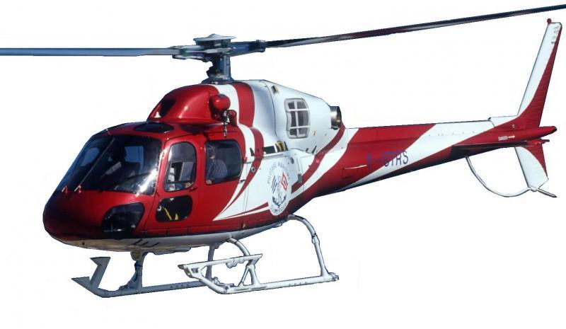
helicopter

Slide 11
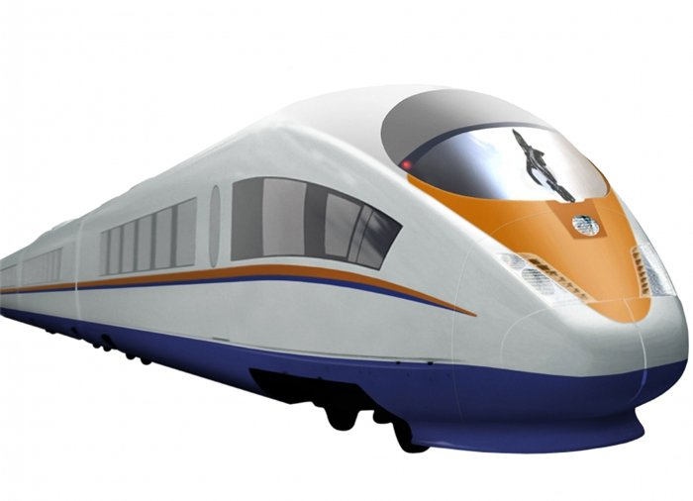
train

Slide 12
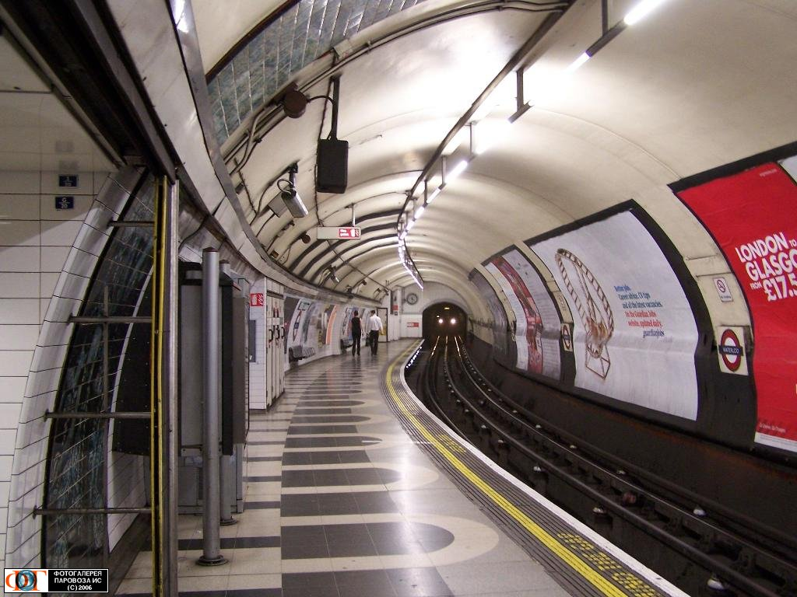
subway/the underground

Slide 13
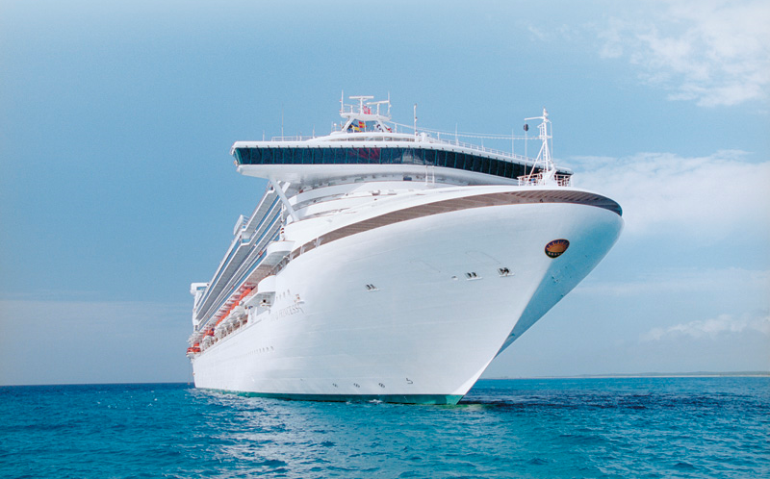
ship

Slide 14
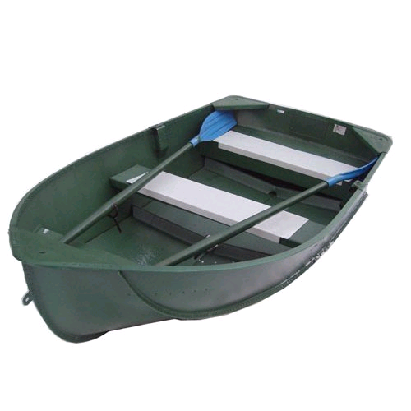
boat

Slide 15
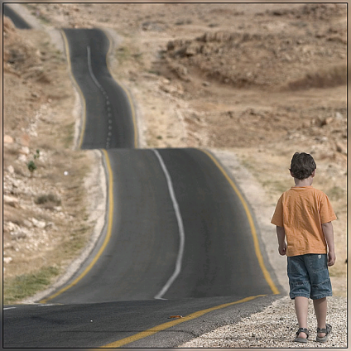
How can people travel?
by bus
by train
on foot
by car
by bicycle
by boat
by ship
by plane

Slide 16
Describe ways of travelling.
the most dangerous
the safest
the fastest
the slowest
the most expensive
the cheapest
the most comfortable
the most uncomfortable
the most exciting
the most boring
the best
the worst
by bus
by car
by train
by plane
by ship
by boat
by bicycle
by motorcycle
on foot
on horseback
Travelling
is

Slide 17
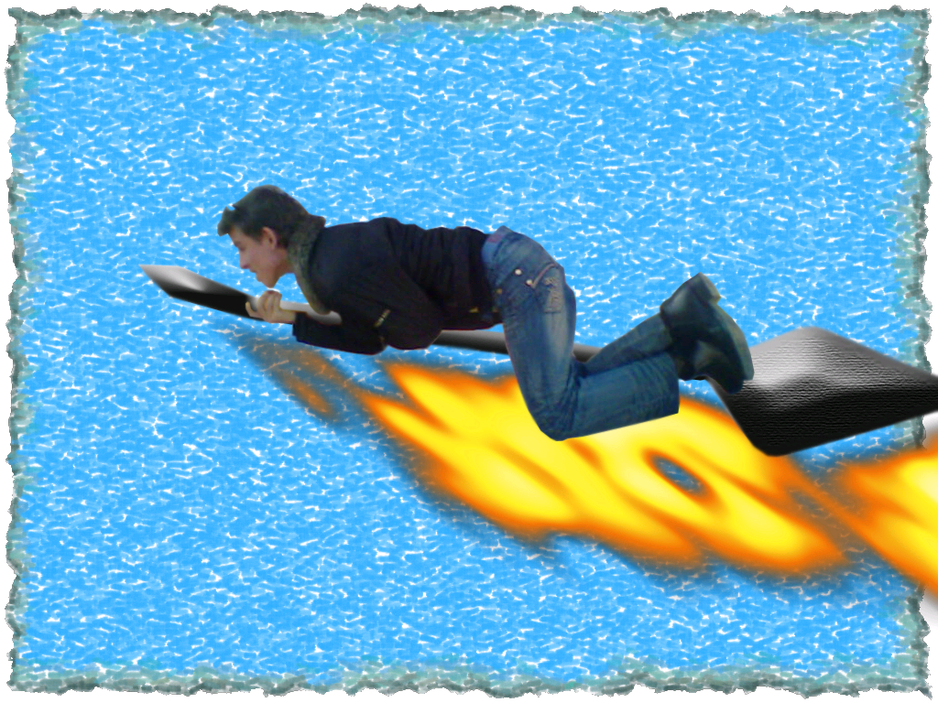
Have a good trip!

